Slide 1

Managed Extensibility Framework (MEF)
By Larry

Slide 2
Agenda
What is MEF
Architecture & Concept
Requirement
How to use

Slide 3
What is MEF
A library for creating lightweight, extensible applications.
Discover and use extensions with no configuration required.
Easily encapsulate code.
Avoid fragile hard dependencies.
Notes:
Managed Extensibility Framework 或 MEF 是用於建立輕量型可擴充應用程式的程式庫。 它可讓應用程式開發人員無需任何設定，即可探索並使用擴充功能。 它也可讓擴充功能開發人員輕易地封裝程式碼並避免出現不牢固的硬式相依性。 透過 MEF，不僅可在應用程式內重複使用擴充功能，也可跨應用程式重複使用擴充功能。
主要側重在 探索性、擴充性、與可移植性

Slide 4
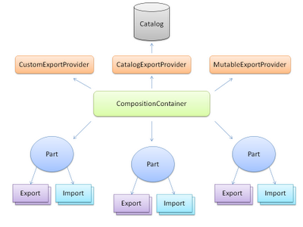
Architecture & Concept
Import
Export
Part
CompositionContainer
Catalog

Slide 5

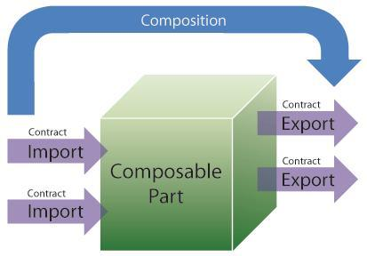
Architecture & Concept

Slide 6
Requirement
Assembly
.NET 3.5+
Silverlight 3.0+
Reference
System.ComponentModel.Composition.dll
Namespace
using System.ComponentModel.Composition;

Slide 7
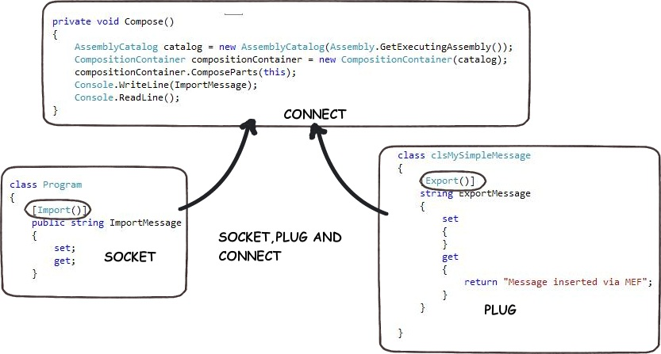
How to use
Step1: Decorate ImportAttribute
Step2: Decorate ExportAttribute
Step3: Compose Import & Export

Slide 8
How to use
[Import]
string message;
...
[Export]
public string Message
{
get { return "Test..."; }
}
...
private void Compose()
{
AssemblyCatalog catalog = new AssemblyCatalog(System.Reflection.Assembly.GetExecutingAssembly());
CompositionContainer container = new CompositionContainer(catalog);
container.ComposeParts(this);
}

Slide 9
How to use
[Import(“Message”)]
string message;
...
[Export(“Message”)]
public string Message
{
get { return "Test..."; }
}
[Export(typeof(IConfigInfo))]
public class MyClass : IConfigInfo {…}
[Import(typeof(IConfigInfo))]
object _port1;
[Import(typeof(IConfigInfo))]
IConfigInfo _port1;
[Import(typeof(IConfigInfo))]
Lazy<IConfigInfo> _port1;

Slide 10
How to use
[InheritedExport(typeof(IRule))]
public interface IRule
public class RuleOne : IRule {…}
public class RuleTwo : IRule {…}
[ImportMany(typeof(IRule))]
List<IRule> _rules;
[ImportMany(typeof(IRule))]
IRule[] _rules;
[ImportMany(typeof(IRule))]
IEnumerable<IRule> _rules;
[ImportMany(typeof(IRule))]
IEnumerable<Lazy<IRule>> _rules;

Slide 11
How to use
public class MyClass
{
[ImportingConstructor]
public MyClass([Import(typeof(IRule))] IRule myRule)
{
_myRule = myRule;
}
}
[Export, PartCreationPolicy(CreationPolicy.Any)]
public class MyClass {…}
[Import]
MyClass _port1;
[Import]
MyClass _port2;

Slide 12
The End
Thank you for your attention

